Slide 1
Project On “ Workout Meter”
Guide by :-
Deviba institute of computer
application, sabargam
Submitted By
Singh Shivam Niranjan
Shaw Aish Bijay
Exam_No :-

Slide 2
Index
Introduction of Proposed System
Scope of Proposed System
Objective of Proposed System
Task dependency Diagram
DFD/UML
Step by Step Screen layouts

Slide 3
Introduction of Proposed System
Workout Meter is a web-based fitness management application
Users can track their daily workouts and progress
The system includes User, Admin, and Seller roles
Provides product browsing, cart, and order features
Replaces manual tracking with a digital solution
Ensures secure login and authentication

Slide 4
Scope of Proposed System
Suitable for individual fitness tracking
Useful for both beginners and gym users
Supports online fitness product management
Multi-user platform (User/Admin/Seller)
Future enhancements may include:
Diet plans
AI-based recommendations
Mobile application integration

Slide 5
Objective of Proposed System
To make fitness tracking simple and efficient
To help users monitor their progress
To reduce manual work and errors
To provide an online platform for fitness products
To develop a secure and reliable system
To ensure a user-friendly interface

Slide 6
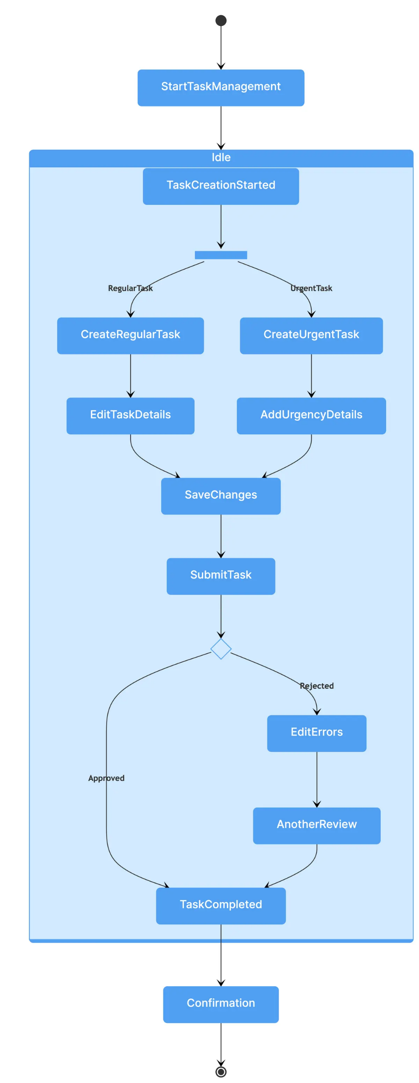
Task Dependency Diagram

Slide 7
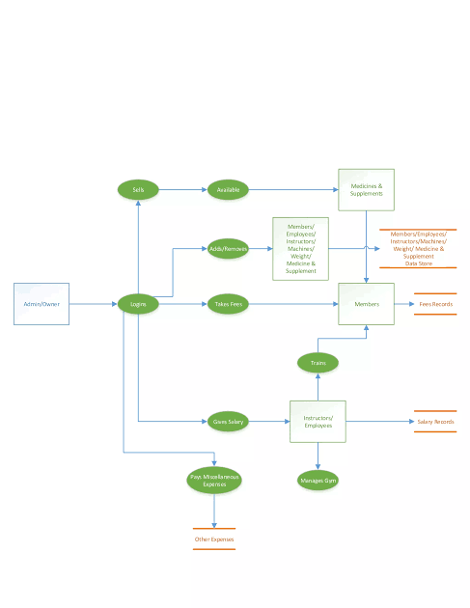
DFD (Data Flow Diagram)

Slide 8
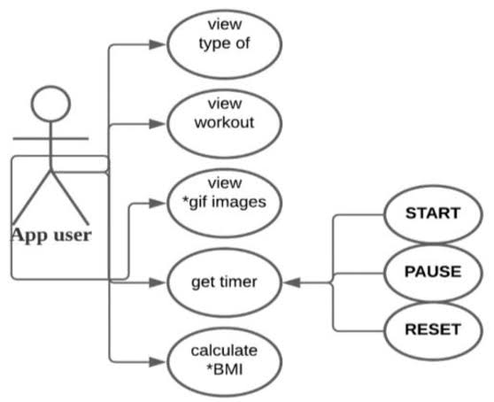
UML Diagram (Use Case Diagram)

Slide 9
Conclusion
Workout Meter is a complete fitness management system
Easy to use and efficient
Built using MEAN stack for high performance
Can be expanded with advanced features in the future

